Slide 1
Franchisee Setup Training

Slide 2
Content
Your Training Sections
Please go through the steps in order
About This Training
The Customer Booking Journey
Connect Stripe
Add Venues
Add Instructors
About Courses, Classes & Lesson
Add Courses
Add Classes

Slide 3
Content
About This Training
The following training is aimed at getting you to the point where you can start to take bookings via FranScape. This involves you setting up all of the Classes for the current/upcoming course.
A further training file will shared that goes through the features and day-to-day management of FranScape in more detail.

Slide 4
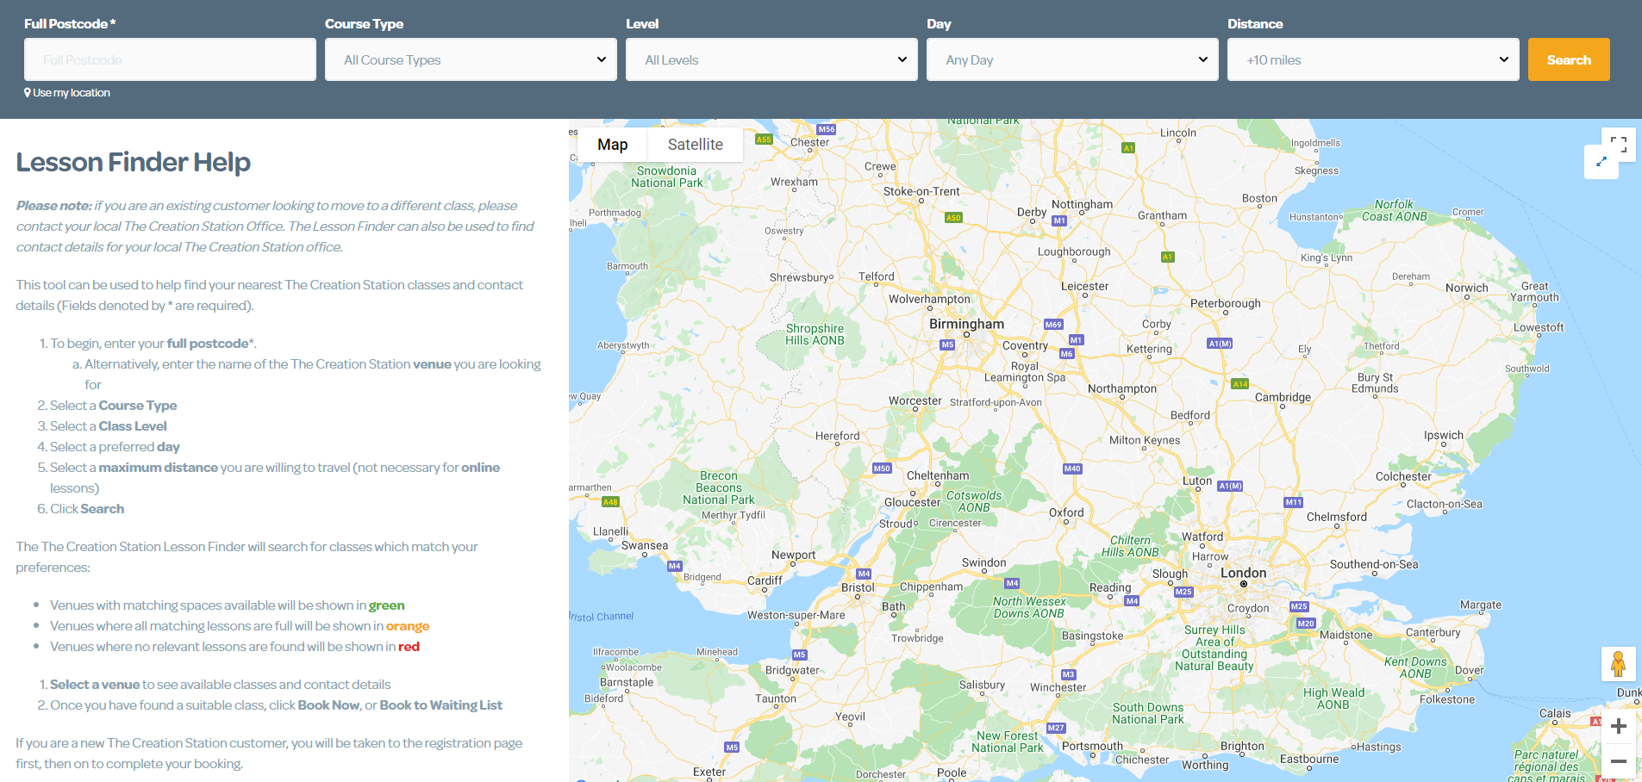
Booking
The Customer Booking Journey
Click on the image below to play the video – you may need to right click for it to open. (an internet connection is required)

Slide 5
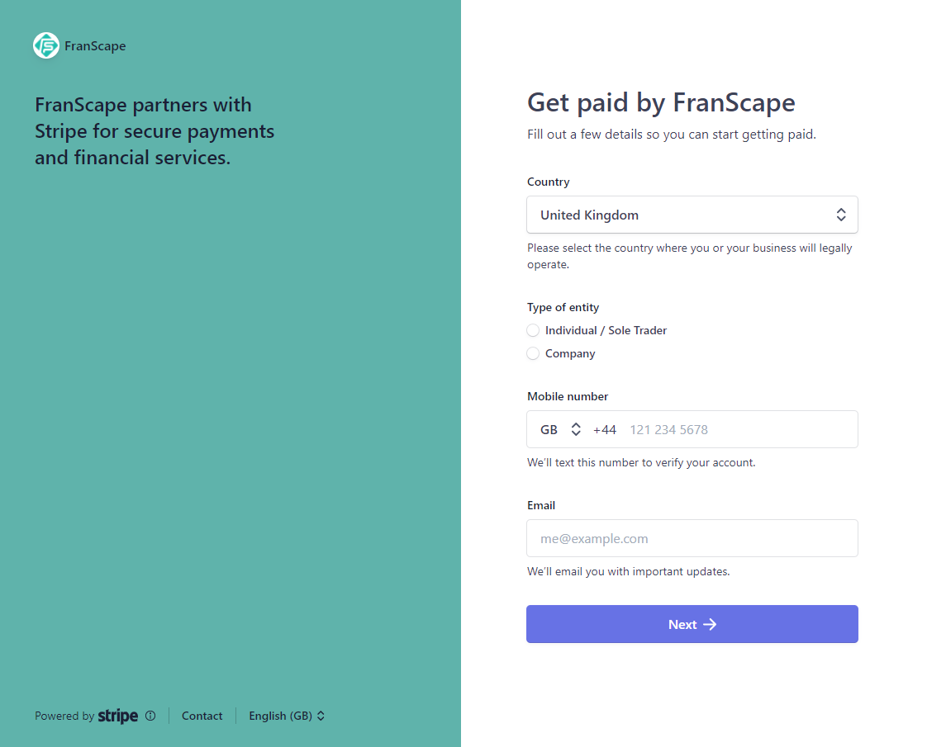
Stripe
Connecting a Stripe Account
Click on the image below to play the video – you may need to right click for it to open. (an internet connection is required)
PLEASE NOTE: Do not connect a Stripe account until you are ready to take bookings.

Slide 6
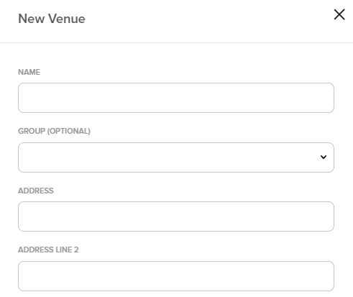
Venues
Adding a Venue
Click on the image below to play the video – you may need to right click for it to open. (an internet connection is required)

Slide 7
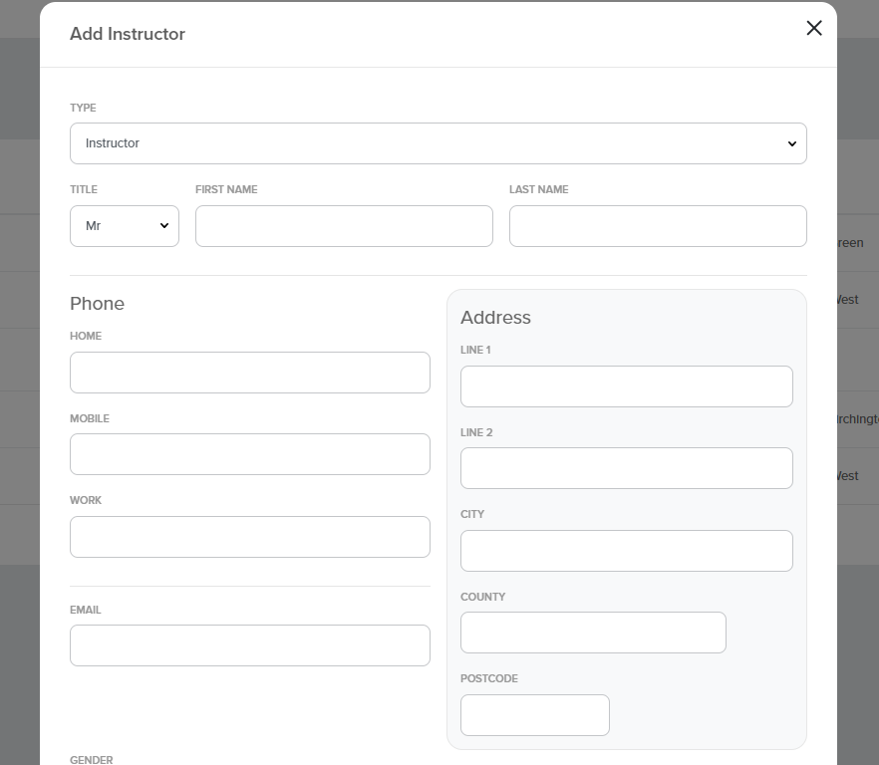
Instructors
Adding an Instructor
Click on the image below to play the video – you may need to right click for it to open. (an internet connection is required)

Slide 8
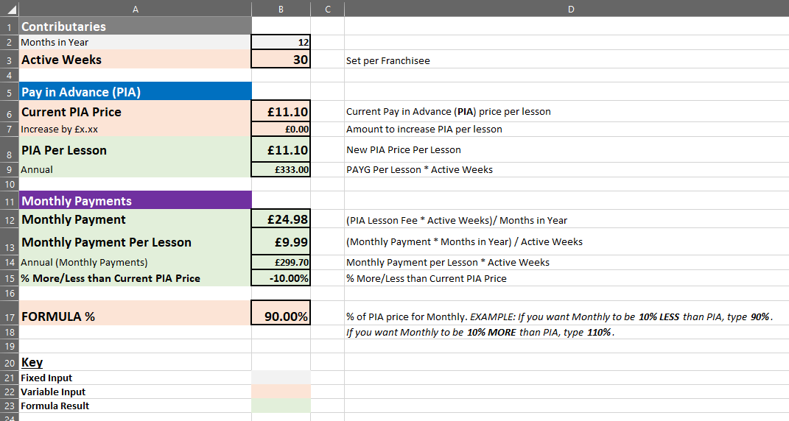
Monthly Plan
Setting My Lesson Prices
Please SKIP this slide if you are not using the Monthly Payments
The cost Per Lesson of the Monthly Plan may be lower than the Paid In Advanced cost Per Lesson. Please contact your Franscape administrator to check, as this is set by your admin.
The basics of the Monthly Plan were explained in the Customer Journey video. Your main responsibility now is to make sure your class prices are set correctly.
Click on the image below to play the video – you may need to right click for it to open. (an internet connection is required)
For further information on the Monthly Plan see the Knowledge Base

Slide 9
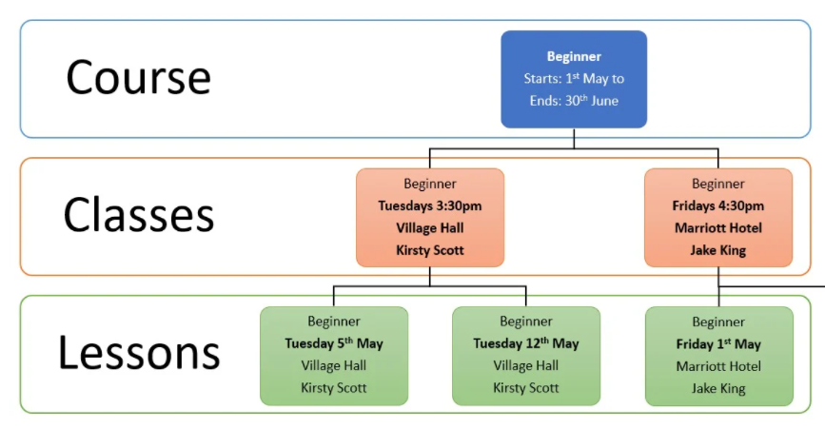
Courses
About Courses, Classes & Lessons
Click on the image below to play the video – you may need to right click for it to open. (an internet connection is required)

Slide 10
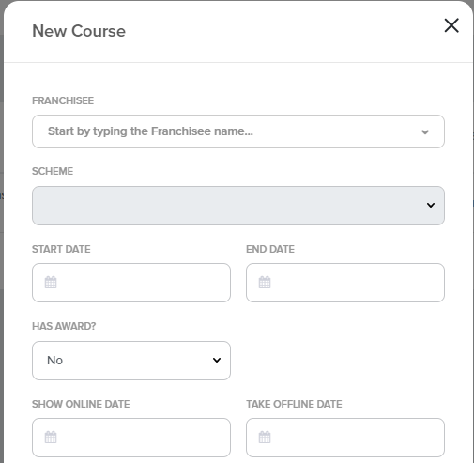
Courses
Add a Course
Click on the image below to play the video – you may need to right click for it to open. (an internet connection is required)

Slide 11
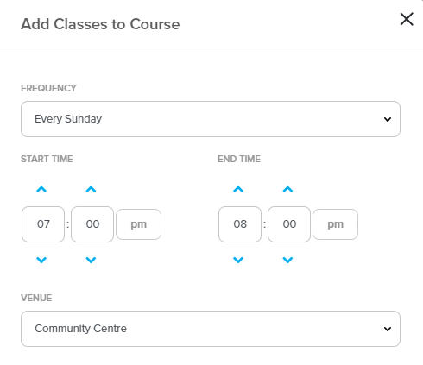
Courses
Add a Class
Click on the image below to play the video – you may need to right click for it to open. (an internet connection is required)

Slide 12
Check out the Franscape Knowledge Base for more instructional articles
If you need support, contact support@franscape.io

